Slide 1
Comparative Analysis of GDP Per Capita and Population
Elijah Abrams, Ridhwaan Ali, Matthew Hagarty, Evan Zhou

Slide 2

Agenda
PROPOSAL
WHY GDP PER CAPITA
CONSTRUCTION OF WEBSITE
MAIN WEBSITE PAGE
LINE CHARTS
BAR GRAPHS
SCATTER PLOTS
LIVE DEMO
CONCLUSION

Slide 3

Proposal
In a world where economic development and the well-being of populations go hand in hand, exploring the intricate relationship between GDP per capita and population data can offer compelling insights. Our proposal is to create an interactive website that seamlessly integrates drop-down menus and data filters, enabling users to delve into this captivating tale and gain a comprehensive understanding of global economic trends.

Slide 4
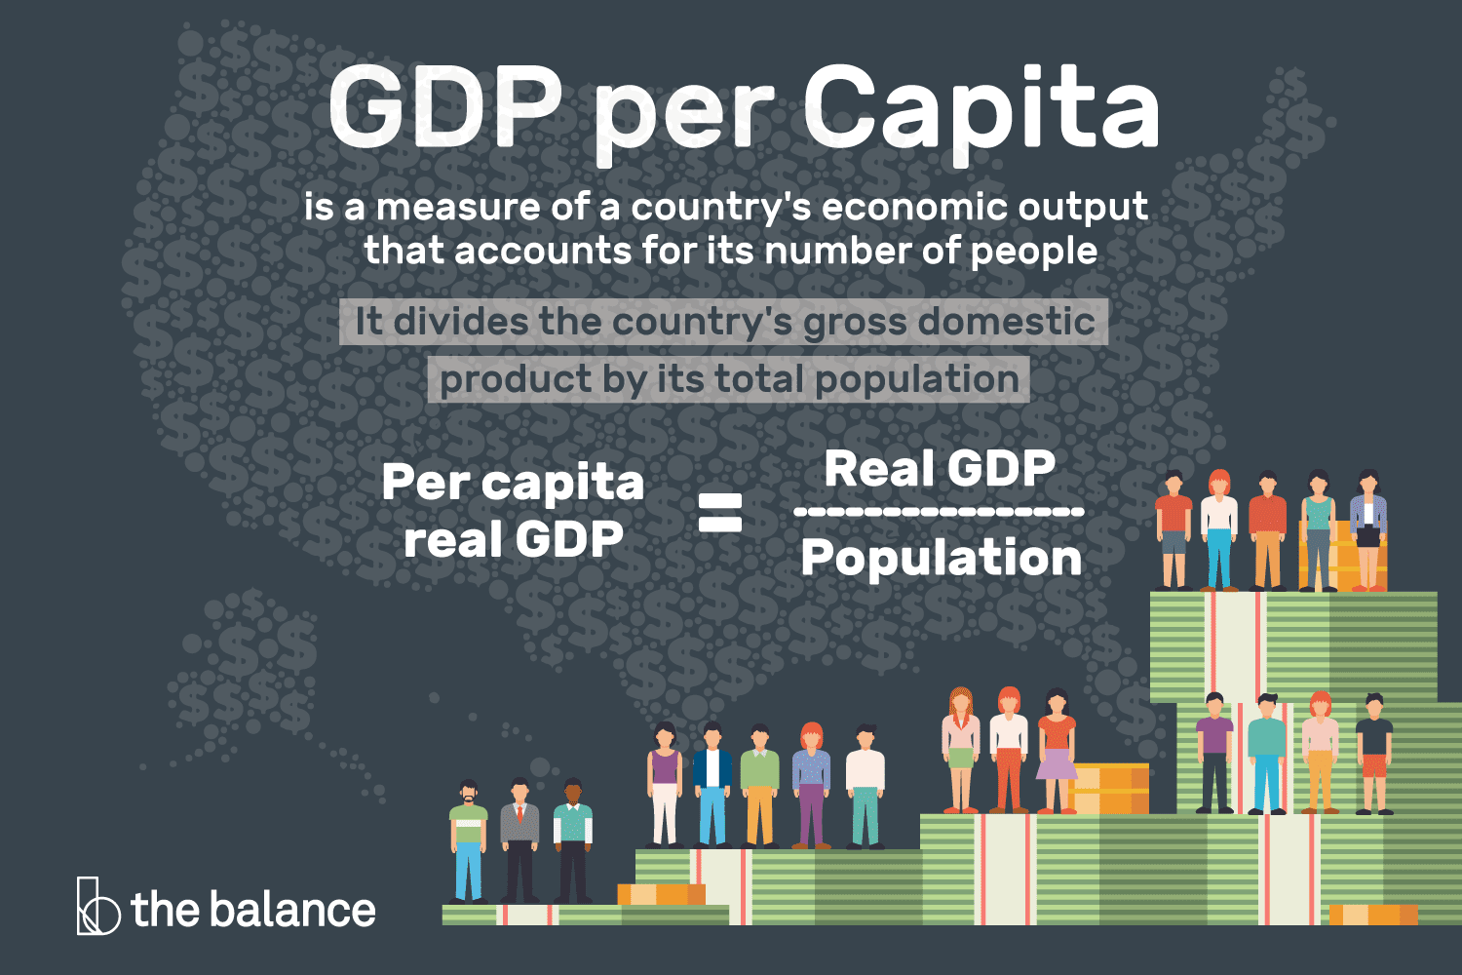
Why GDP Per Capita
Focuses on individual economic perspective
Assesses citizens' economic well-being
Measures living standards
Facilitates cross-country comparisons. Accounts for population differences

Slide 5

Constructing The Website
Website Composition:
HTML (HyperText Markup Language)
JSON (JavaScript Object Notation)
JS (JavaScript)
PY (Python)

Slide 6
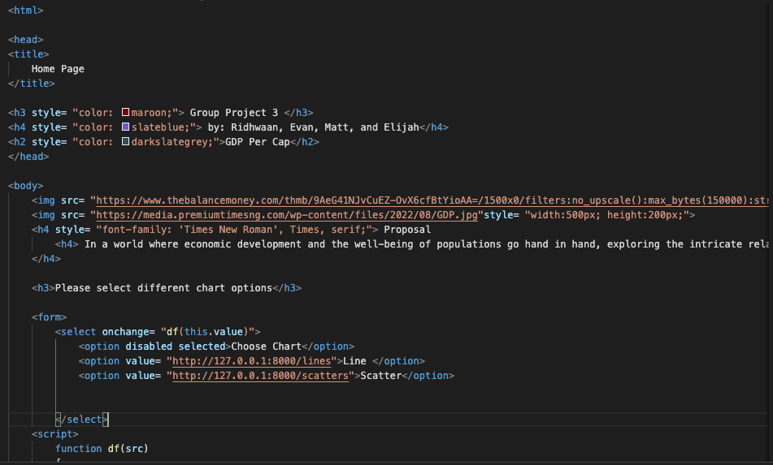
Front End (UI)
Front-End UI:
Constructed using HTML
Styled using CSS
Home.html:
Represents a primary webpage
Contains the user interface components
Incorporates HTML structure and content
Styled using embedded CSS

Slide 7
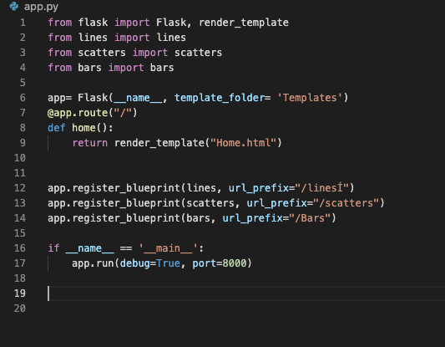
Back End (Execution)
Database
MongoDB
Json
Website Setup:
Built using Python Flask framework
Hosted on local port 8000.
App.py:
Central Python script
Links various HTML files
HTML Files:
Multiple HTML files used
Each HTML file has its own associated Python code
Facilitates connection with app.py
Enables interaction with the local port
Database Implementation:
Utilizing JSON format
Accessed through JavaScript
JavaScript Usage:
Incorporating JavaScript for multiple functionalities
Importing JSON database. Used for plotting data.

Slide 8
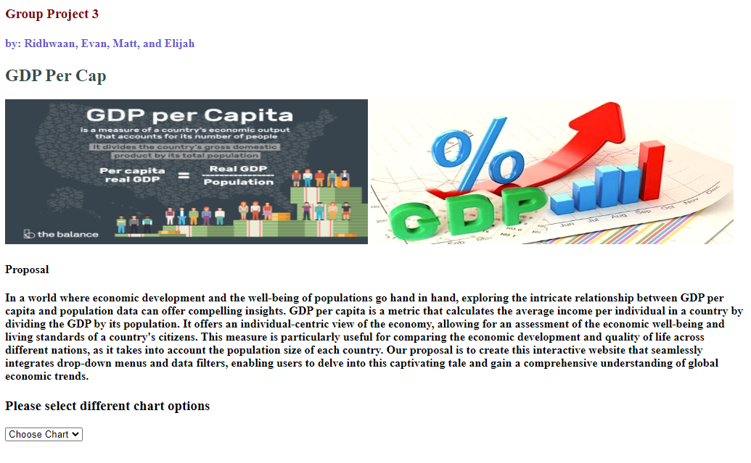
Website Home Page

Slide 9
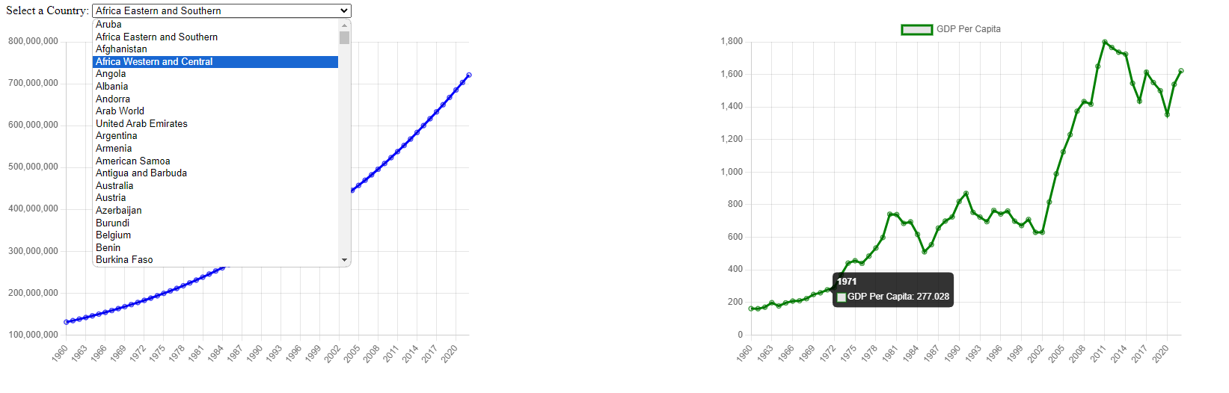
Line Charts

Slide 10
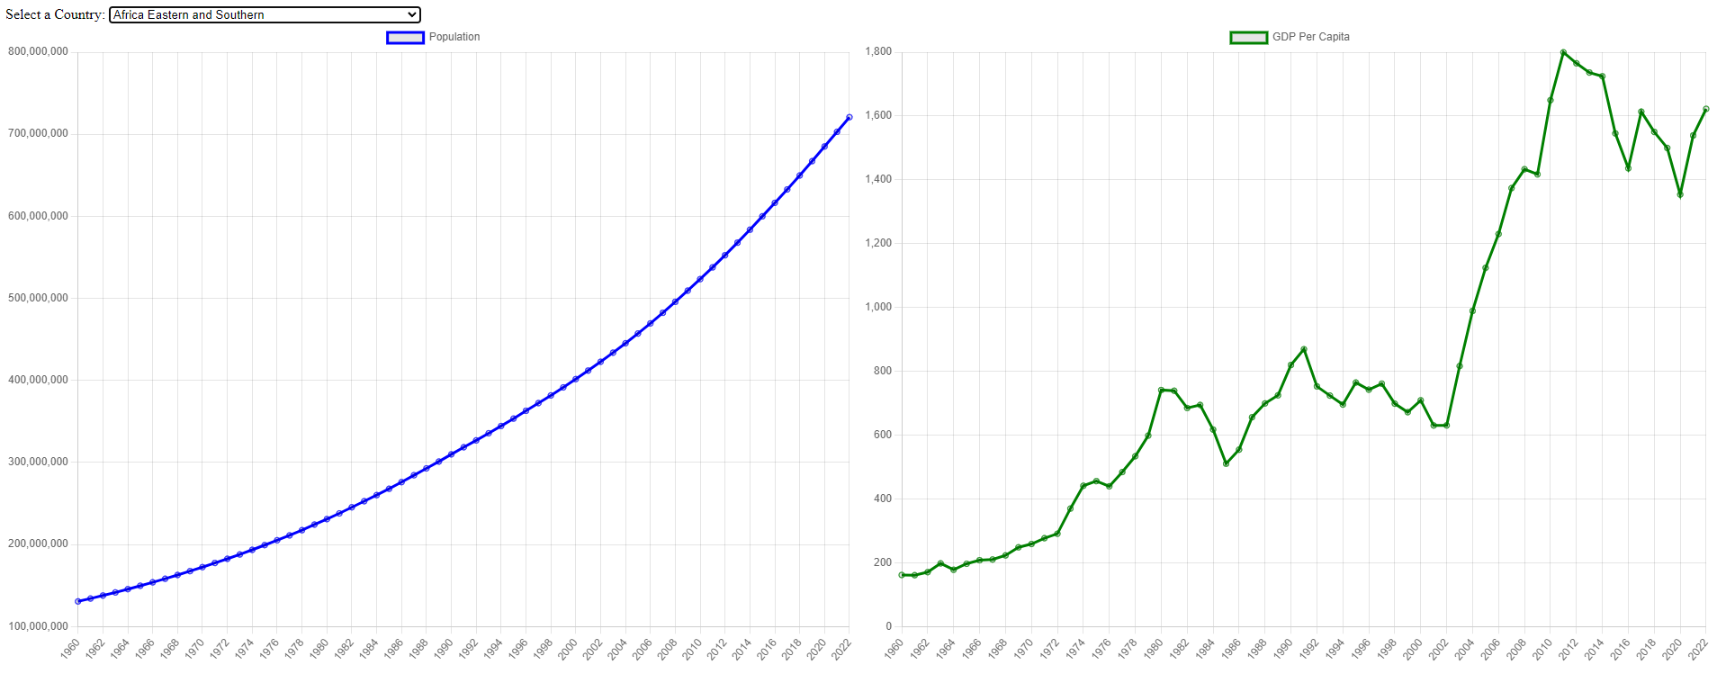
Line Charts

Slide 11
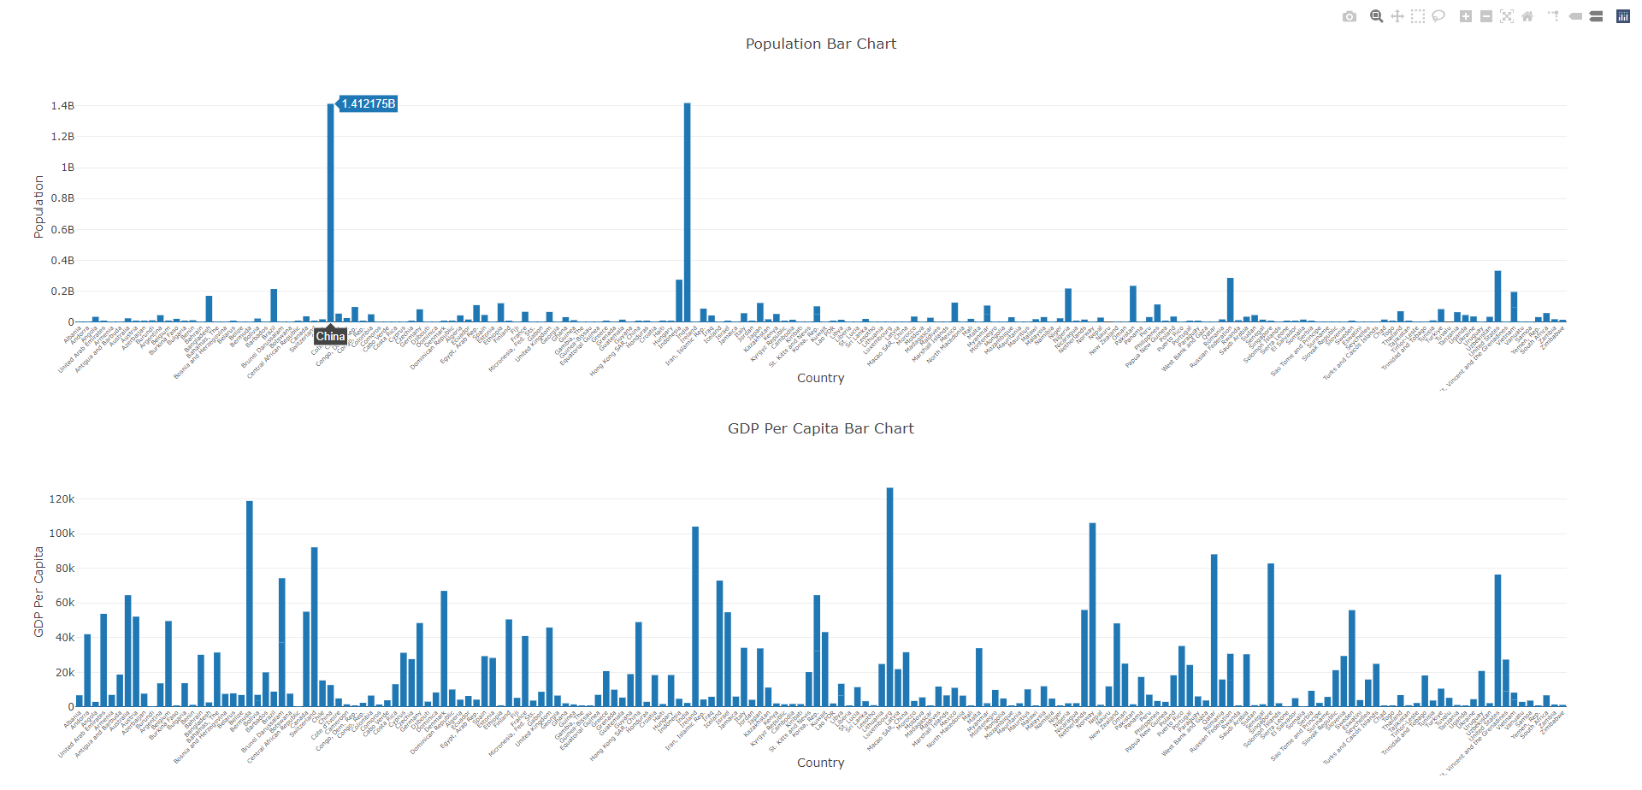
Bar Graph

Slide 12
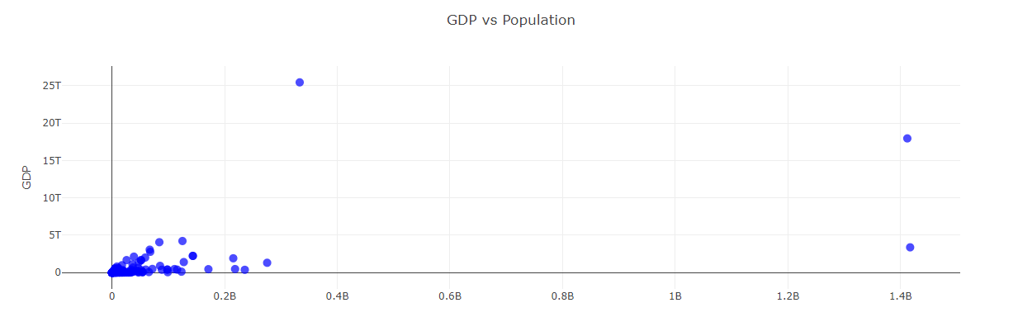
GDP VS Population Scatter Plot

Slide 13
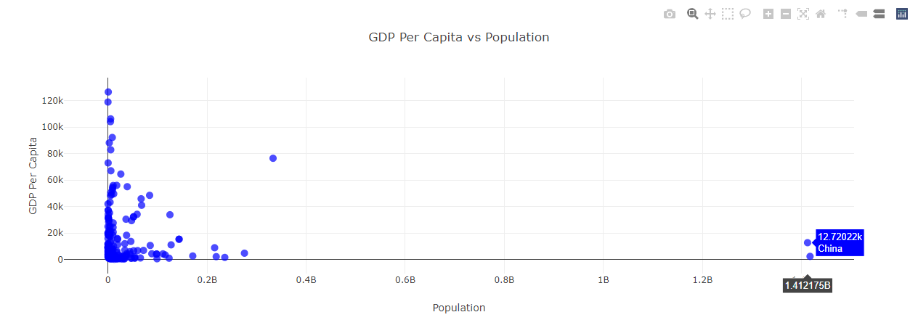
GDP Per Capita VS Population Scatter Plot

Slide 14
Conclusion
Diverse Trajectories
The relationship between population and GDP per capita varies across countries.
Population Impacts on GDP
Population size does exert on GDP.
DOES NOT exert an influence on GDP per capita.
Beyond Population
Population size is not the sole determinant of economic prosperity.
Small Populations, High GDP
Smaller populations can achieve impressive GDP per capita figures by effectively utilizing their resources, investing in education and innovation, and creating a conducive environment for businesses.

Slide 15


